Slide 1
3rd Party Suspense Report
County of San Diego

Slide 2
Who should run this report?
  All programs.
When should this report be run?
  This report should be run every month for services with-in 12 months. Typically towards the end of the month, once the mass recalculation has been performed by the MHBU.

Slide 3
This report tells you:
When services are in suspense. Suspense means your services cannot bill until the issues are corrected.
The main reason for the suspense action. Each suspense code is defined at the bottom or on the next page of the report.
The amount of money that the County is not being reimbursed for due to services being in suspense.

Slide 4
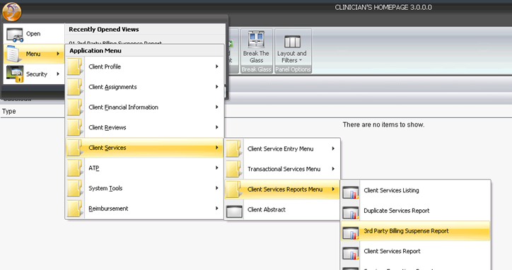
How do I run it?

Slide 5
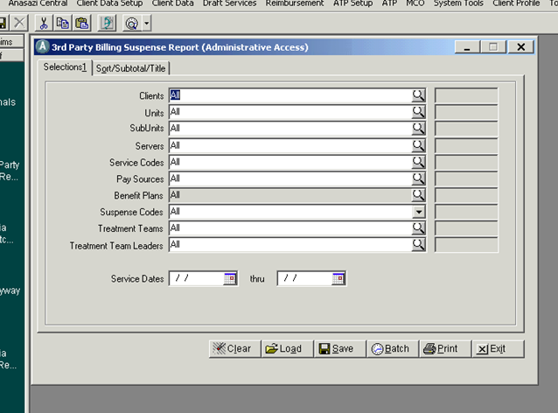
Load your template
Click on Load to view the available templates.

Slide 6
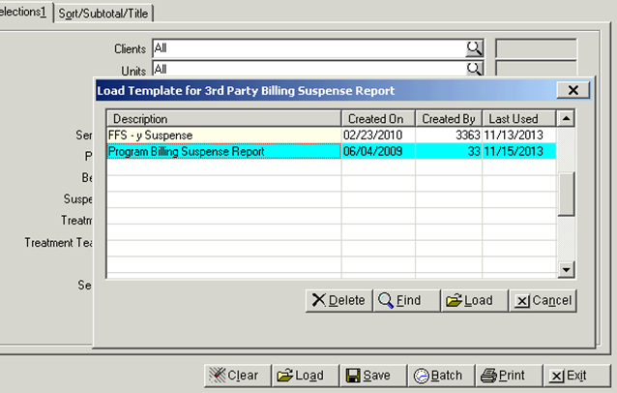
Choose the correct template

Slide 7
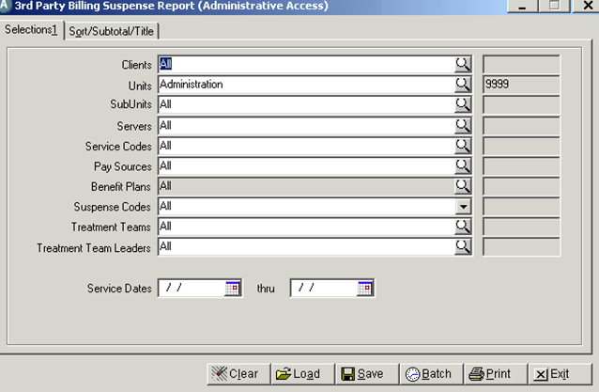
Tailor to your needs
Enter YOUR Unit/SubUnit
Select a date range

Slide 8
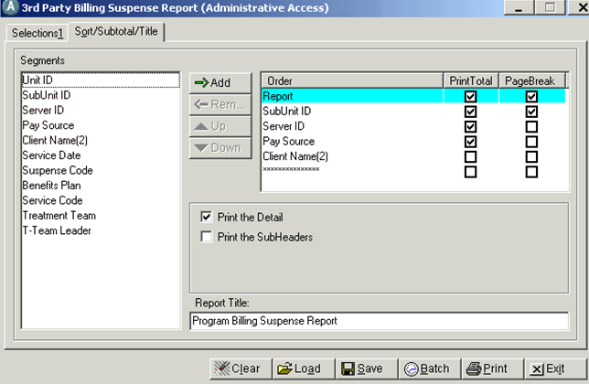
Sor/Subtotal/Title
You can choose to sort the information by any of these fields. Add them to the field on the right and select your priority order by moving them up or down
You can rename it as you wish or just print as is.

Slide 9
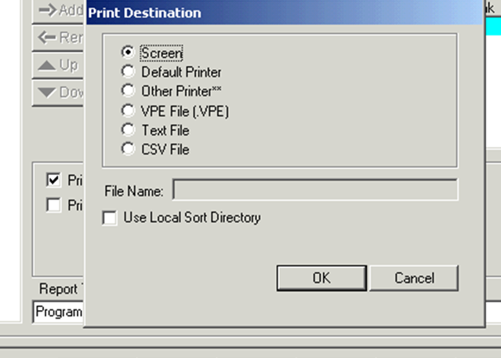
Print

Slide 10
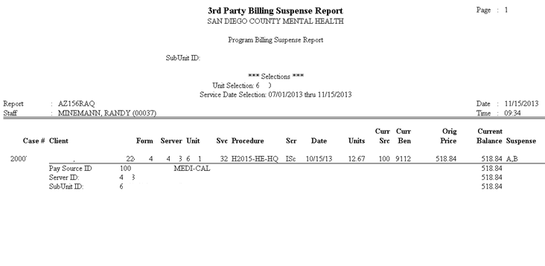
Your report

Slide 11
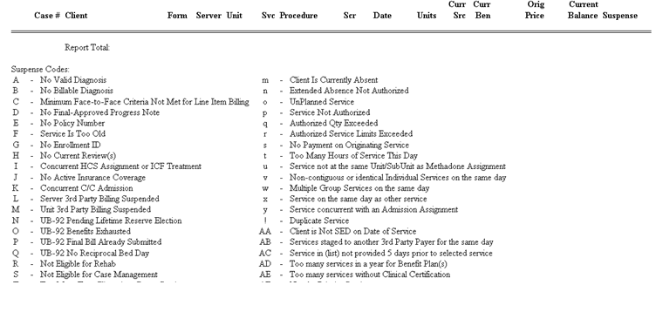
The legend to the codes

Slide 12
What do I do now?
Now that you can identify what services are in suspense and what the suspense codes are;
  You can refer to the “Correcting Items in Suspense” sheet that has been provided. (it can also be found in the updated Financial Billing Manual at the Optum Website)
  The majority of the suspense reasons you can fix yourself if you have questions or can not fix, you may need to contact either Optum, MHBU, QI Matters or MHMIS.

