Slide 1
STEPS ON
HOW TO RUN
998 REPORT

Slide 2

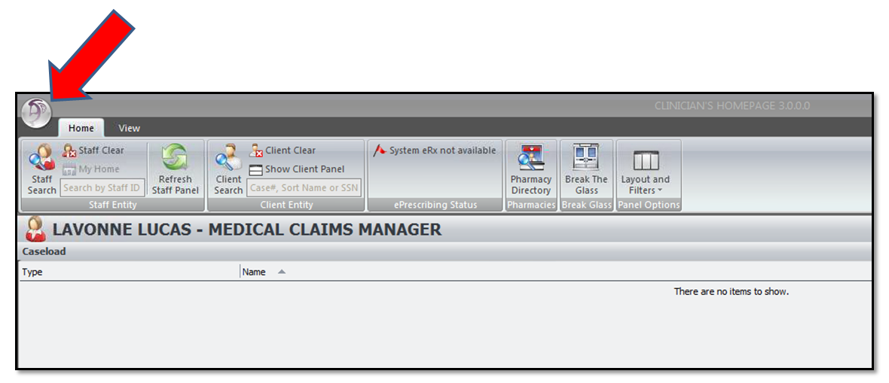
Click this symbol

Slide 3
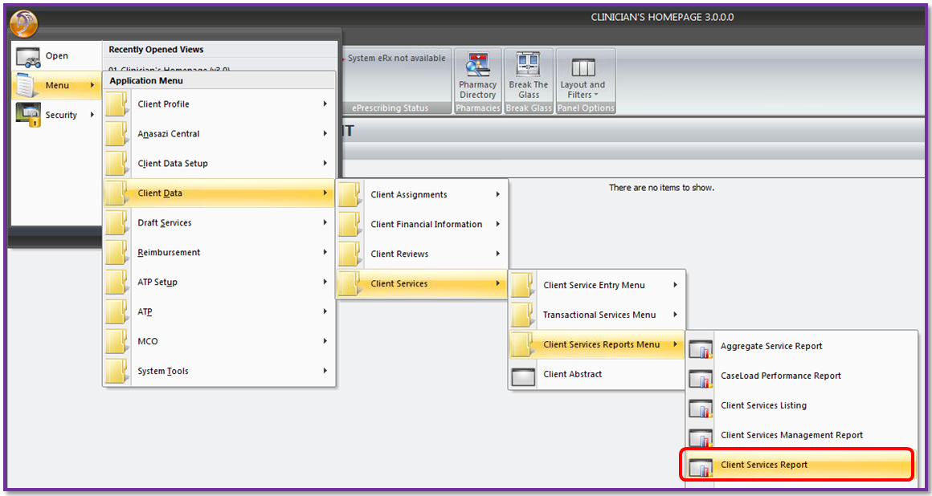
Open “Client Services Report”

Slide 4
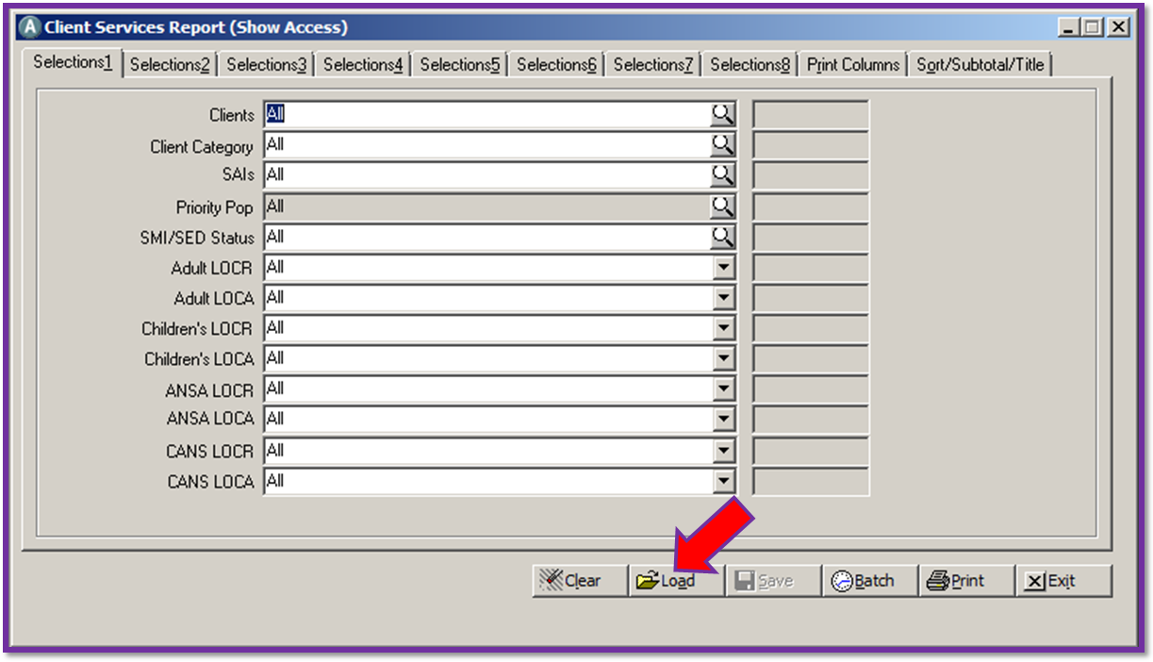
Load the template

Slide 5
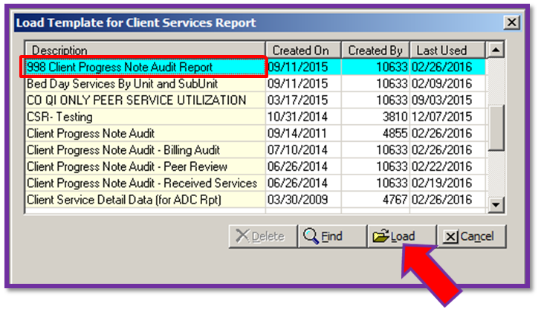
Select “998 Client Progress
Note Audit Report”

Slide 6
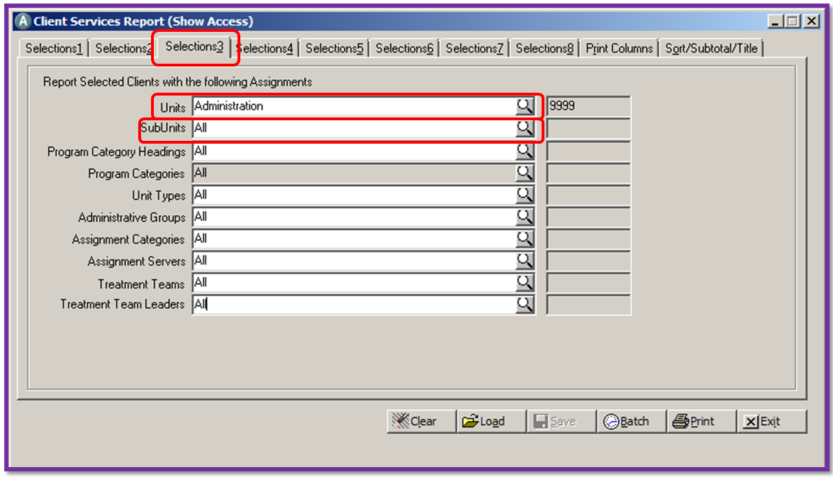
Selection 3
Enter UNIT/SubUnit

Slide 7
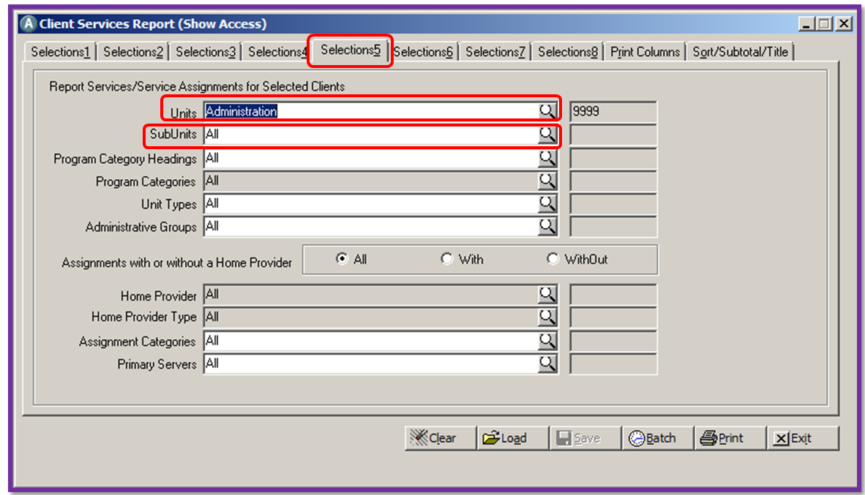
Selection 5
Enter UNIT/SubUnit also

Slide 8
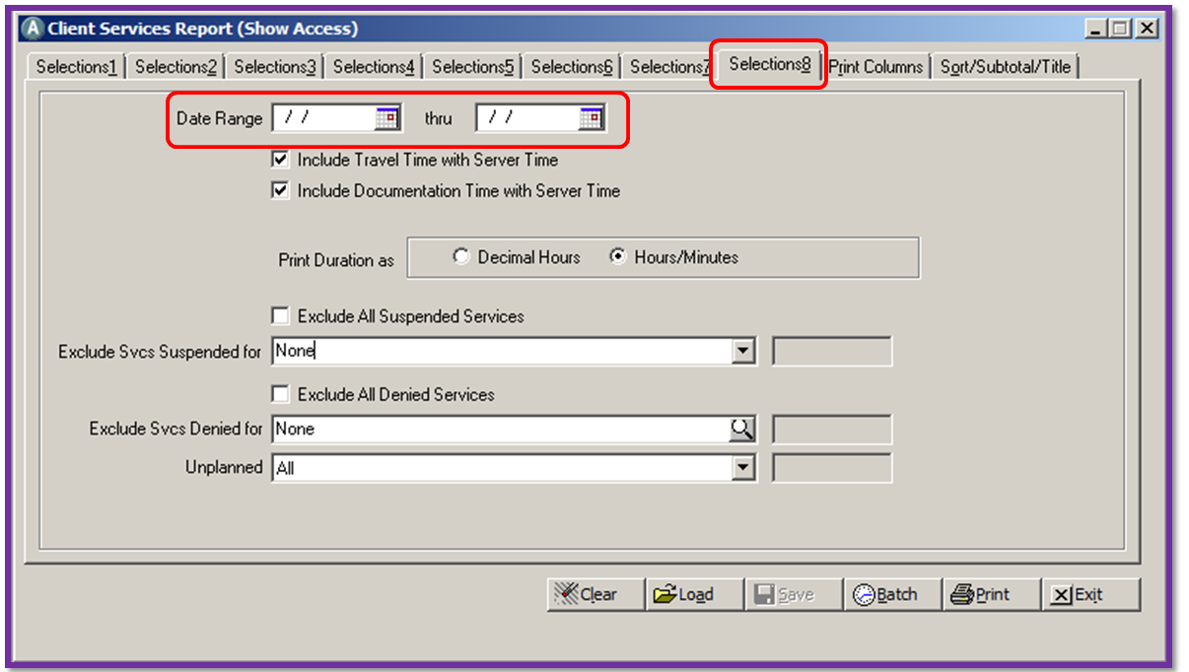
Selection 8
Enter Date Range, etc.

Slide 9
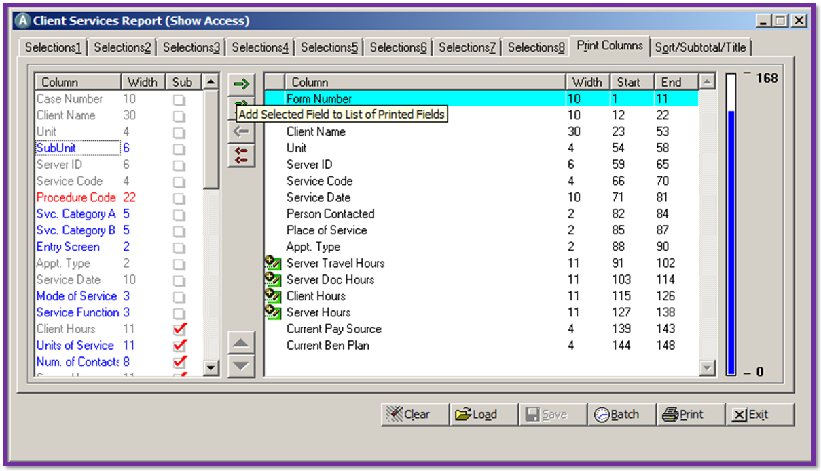
Print column can be updated if you would like to add the SubUnit

Slide 10
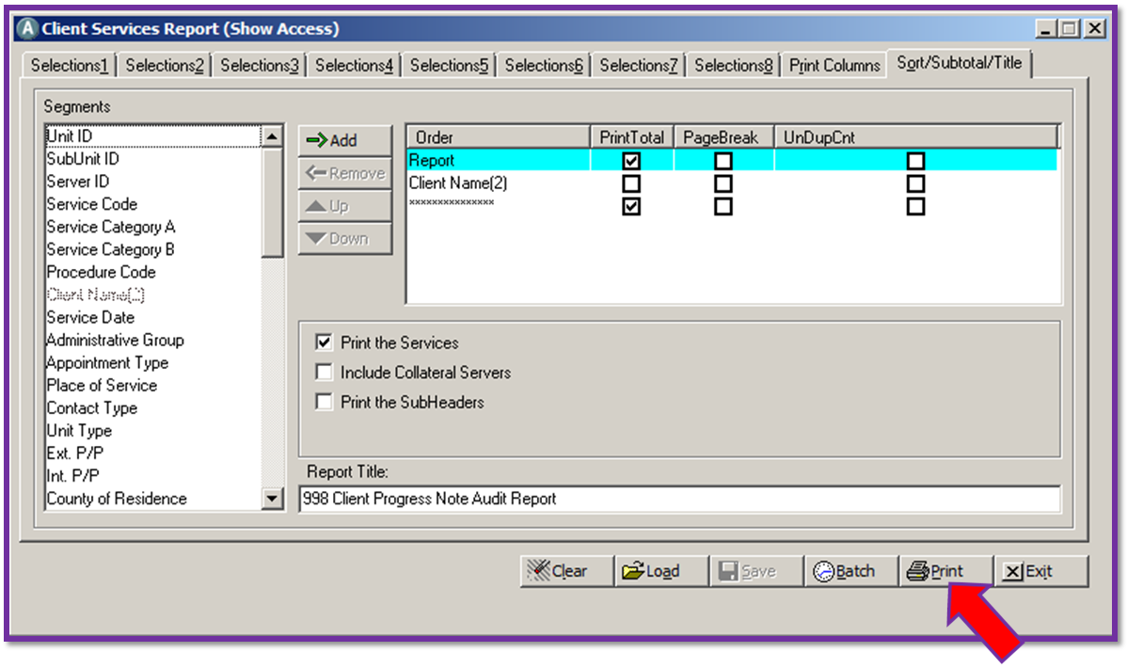
Click “Print”

Slide 11
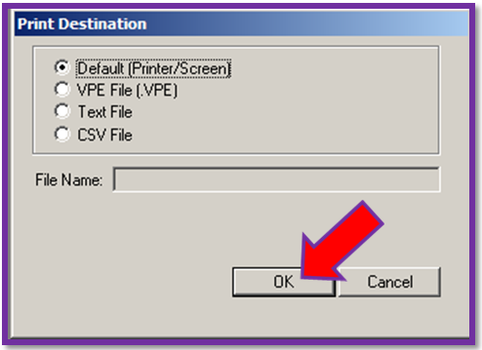
Have a choice of printing or saving it as a CSV to a folder.
Then click “OK”

Slide 12
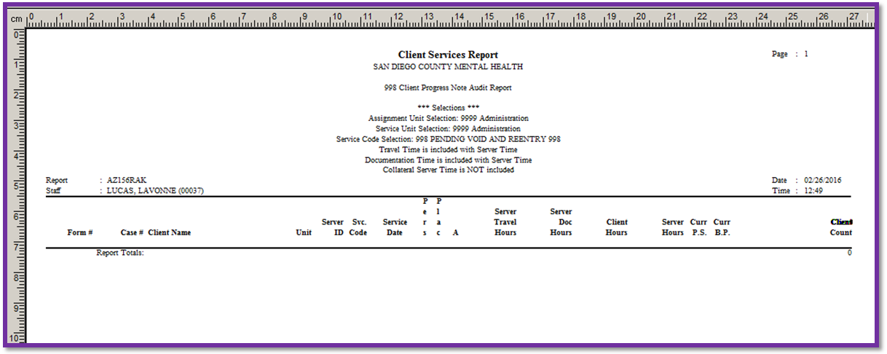
Client Services Report

Slide 13
Thank you.

